Slide 1
Multidimensional Scaling(MDS) Distances, Inner Products

Slide 2

Recall: PCA Optimization
PC1 optimization
$$\max_{v}{{L\left(v, λ\right)= v}^{T}Σv−λ(v^{T}v−1\text{) }}$$
Designed to maximize data variance in new/projected dimensions
But: Variance is not necessarily the sole quantity want to preserve.

Slide 3
Distance/Proximities Preservation
Motivation 1: Preserving distances between datapoints in lower dimensions
Motivation 2: Given a set of dissimilarities or proximities between datapoints---do not have coordinates
find coordinates in an axes where the points actually have these pairwise distances

Slide 4
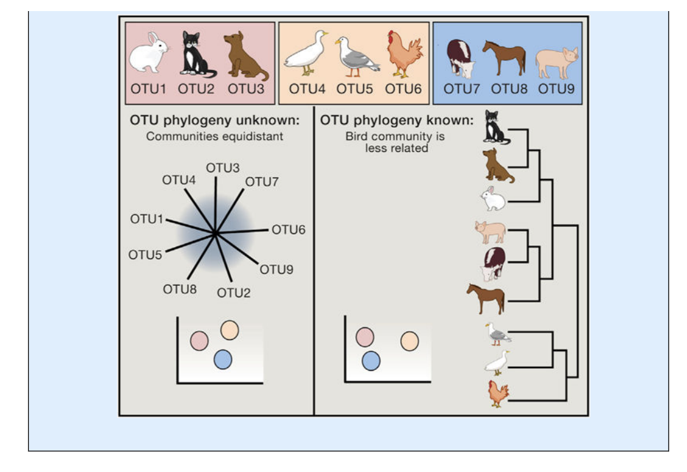
Example: Gut Microbiota
Can place gut microbial species on a phylogeny
Distance between microbial populations an earth mover’s distance (called Unifrac) which measures displacement along a tree
Goodrich et al. Cell 2014

Slide 5
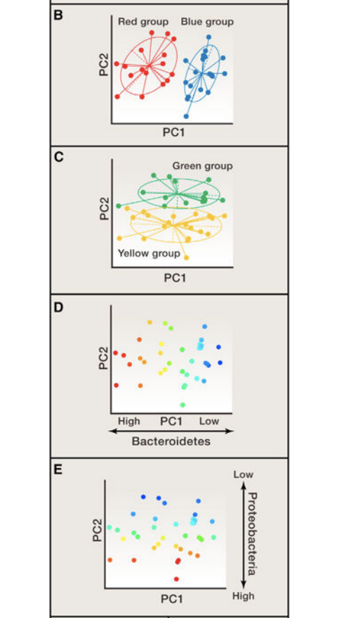
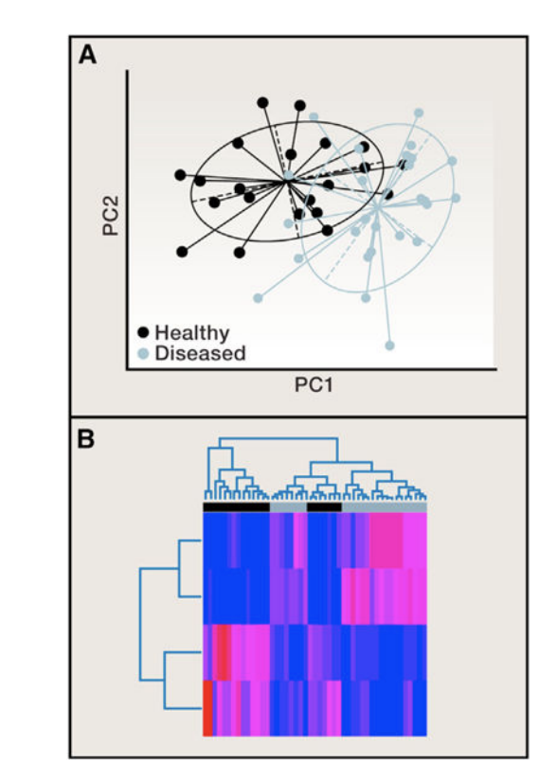
Example: Visualizing people based on microbiome distances

Slide 6
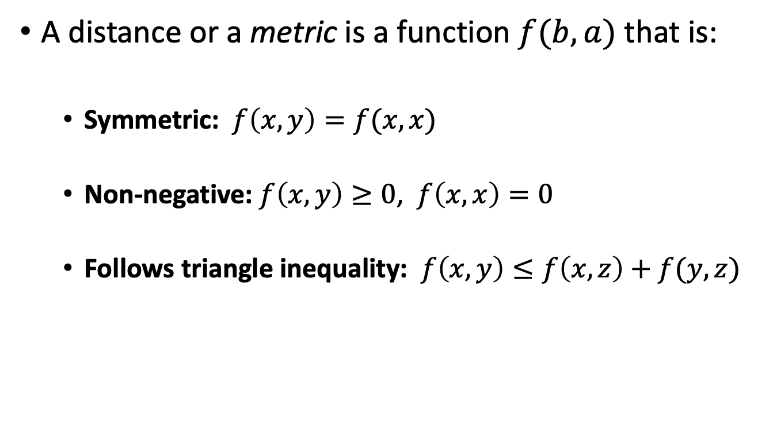
Distance Metrics
A distance or a metric is a function $f(b,a)$ that is:
Symmetric:$f\left(x,y\right)=f(x,x)$
Non-negative: $f\left(x,y\right)≥0$, $f\left(x,x\right)=0$
Follows triangle inequality: $f\left(x,y\right)≤f\left(x,z\right)+f(y,z)$

Slide 7
Triangle Inequality

Slide 8
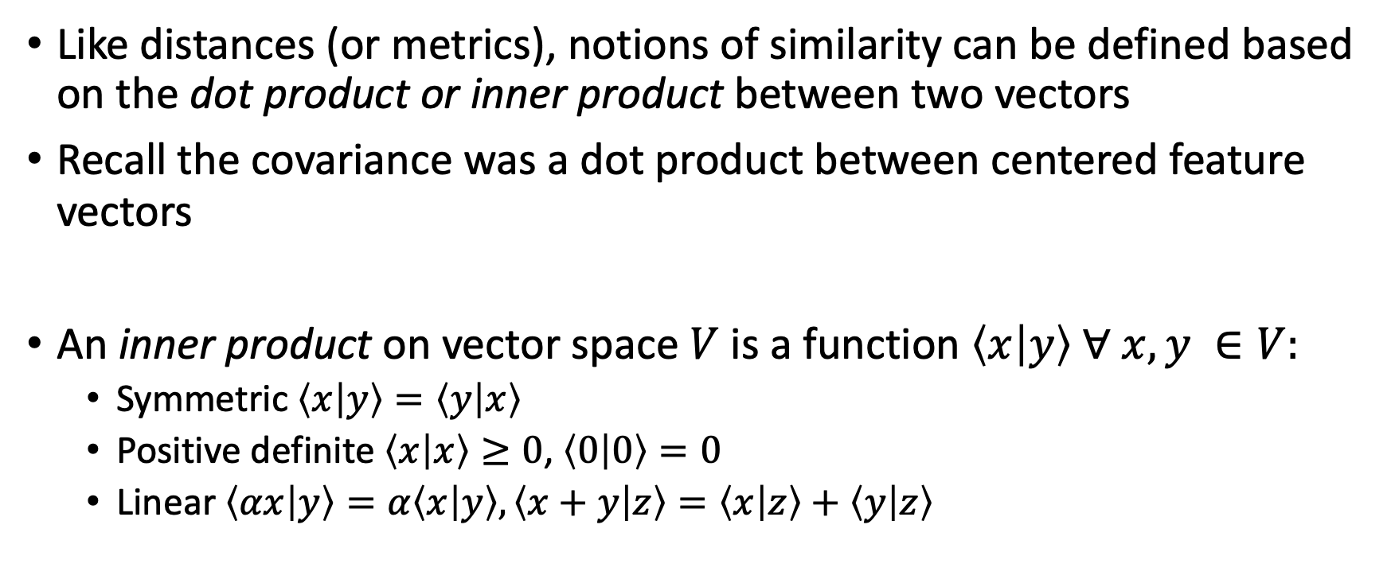
Inner products
Like distances (or metrics), notions of similarity can be defined based on the dot product or inner product between two vectors
Recall the covariance was a dot product between centered feature vectors
An inner product on vector space $V$ is a function $\left\langle x | y\right\rangle ∀ x,y ∈V:$
Symmetric $\left\langle x | y\right\rangle =\left\langle y | x\right\rangle$
Positive definite $\left\langle x | x\right\rangle ≥0$, $\left\langle 0 | 0\right\rangle =0$
Linear $\left\langle αx | y\right\rangle =α\left\langle x | y\right\rangle , \left\langle x+y | z\right\rangle =\left\langle x | z\right\rangle +\left\langle y | z\right\rangle$

Slide 9
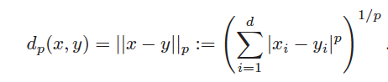
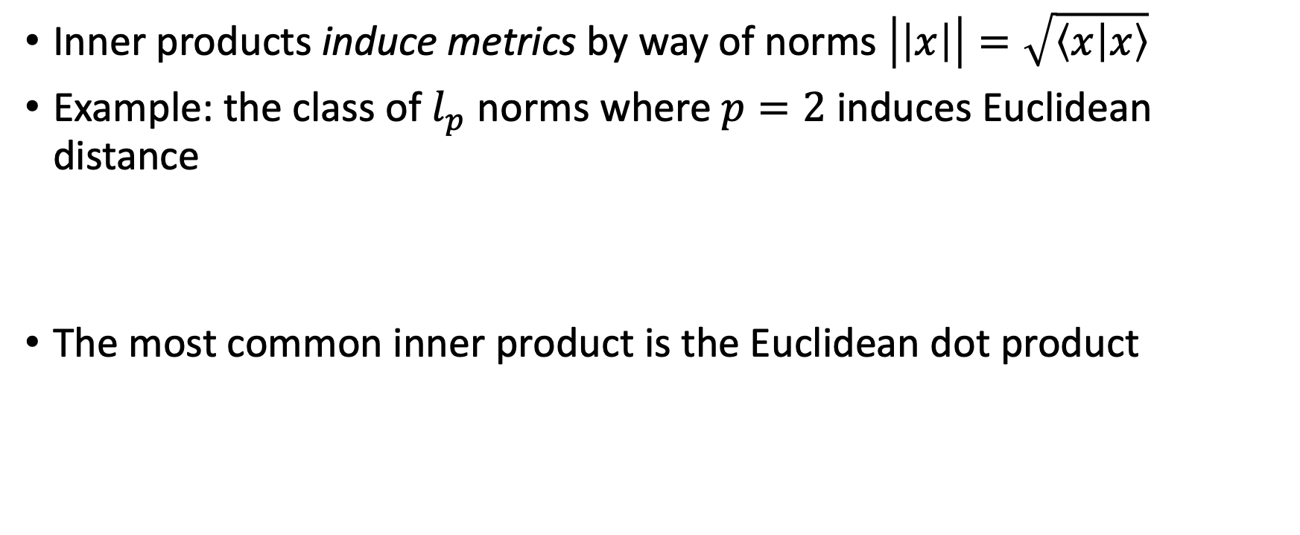
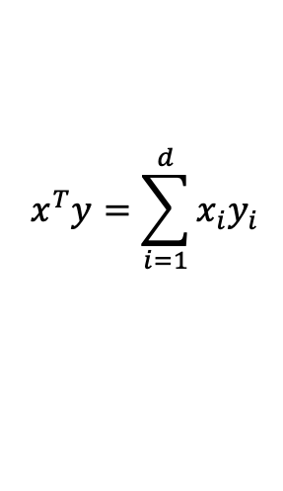
Euclidean dot product, induced norm
Inner products induce metrics by way of norms $\left|\left|x\right|\right|=\sqrt{\left\langle x | x\right\rangle }$
Example: the class of $l_{p}$ norms where $p=2$ induces Euclidean distance
The most common inner product is the Euclidean dot product
$$x^{T}y=\sum_{i=1}^{d}{x_{i}y_{i}}$$

Slide 10
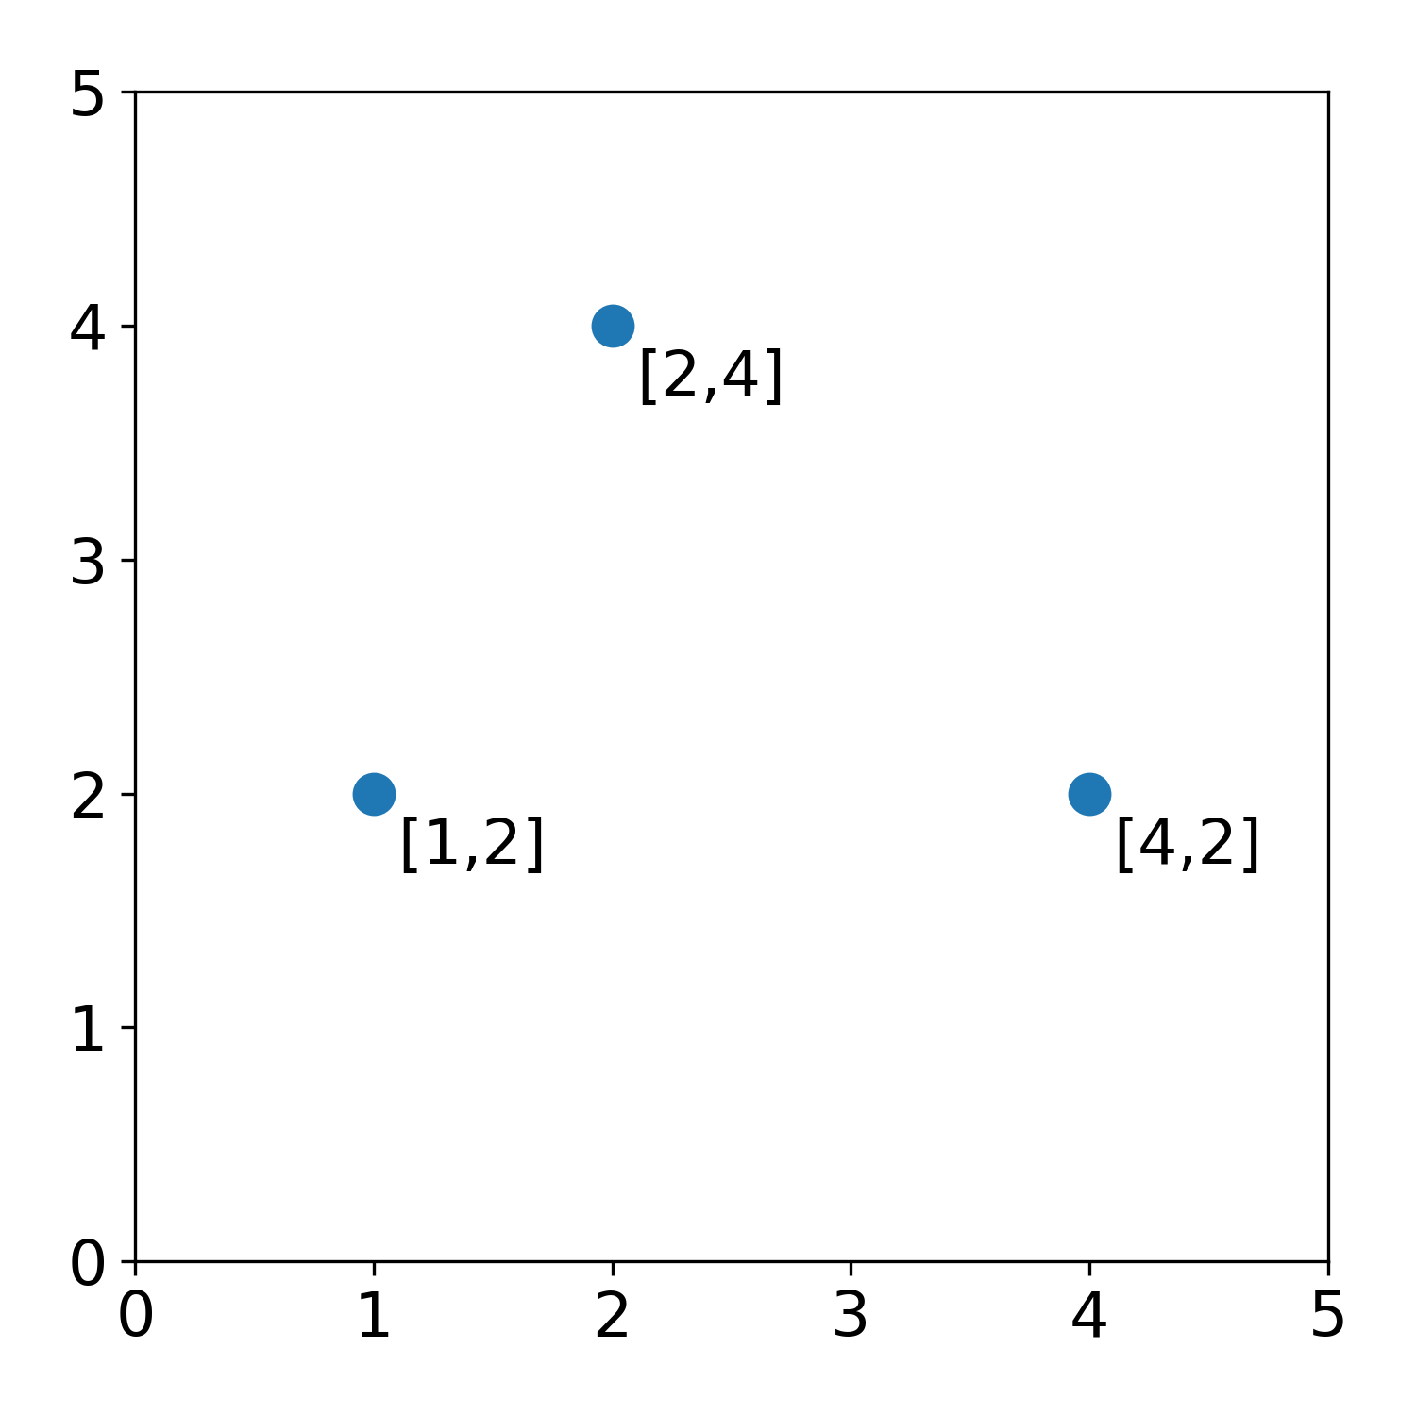
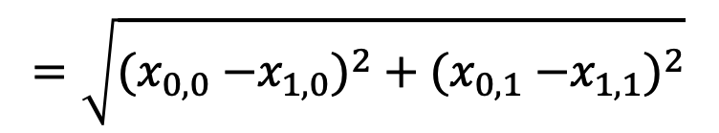
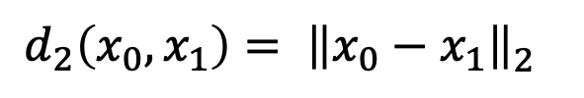


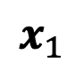
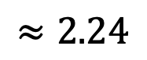

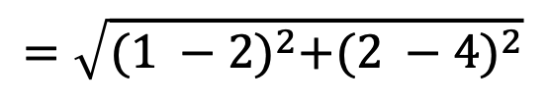
Euclidean Distance
$$x_{1}$$
$$d_{2}\left(x_{0},x_{1}\right)= {\left\|x_{0}−x_{1}\right\|}_{2}^{}$$
$$\text{2.24}$$
$$=\sqrt{{{(x}_{0,0} −x_{1,0})}^{2}+{{(x}_{0,1} −x_{1,1})}^{2}}$$
$$x_{0}$$
$$x_{2}$$
$$=\sqrt{{(1 −2)}^{2}+{(2 −4)}^{2}}$$
$$≈2\text{.24}$$

Slide 11
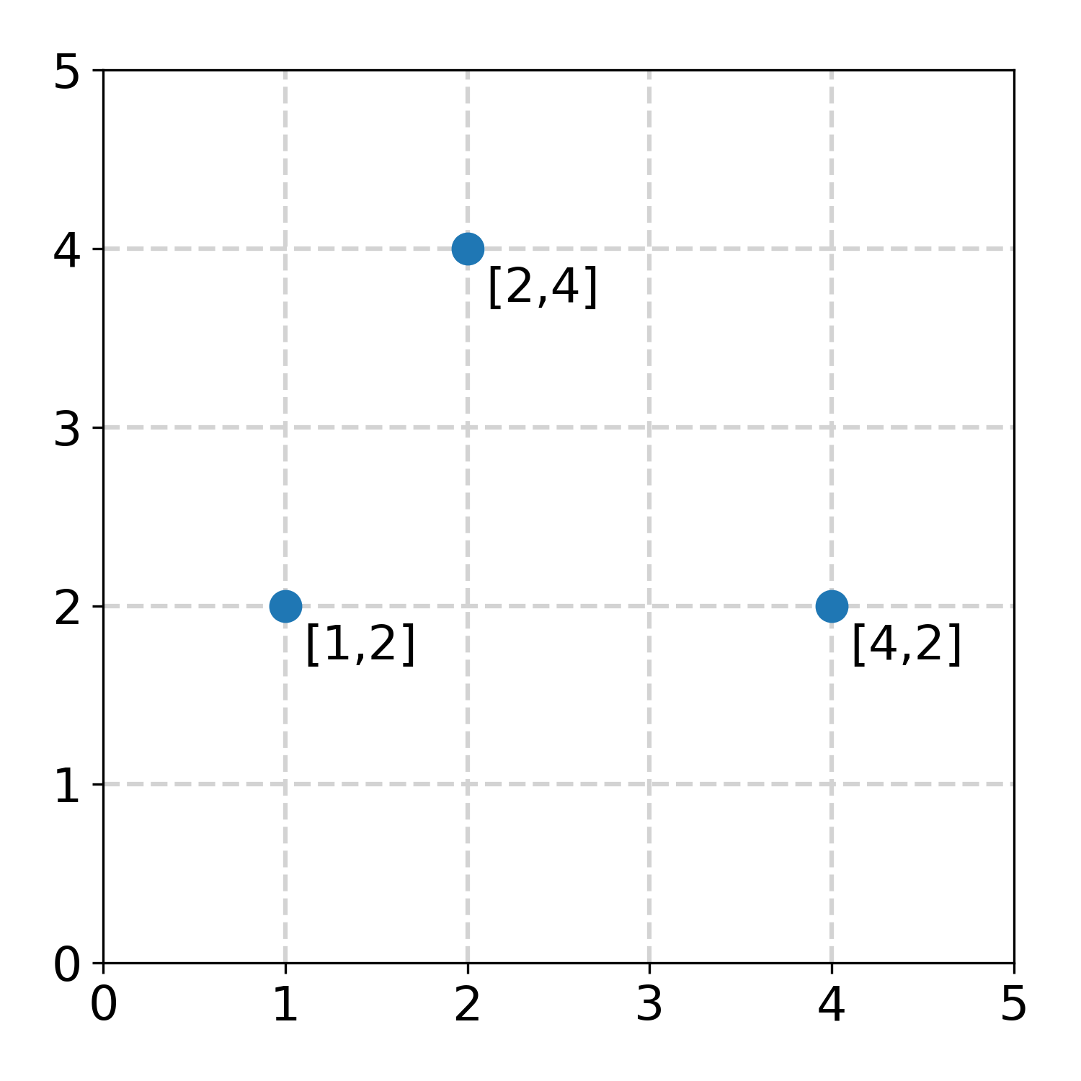
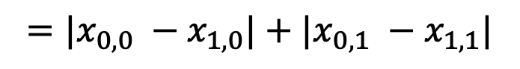
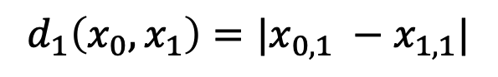

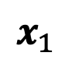
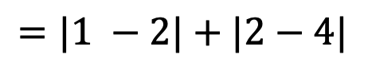

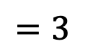
Manhattan Distance
Manhattan distance
$$x_{1}$$
$$d_{1}\left(x_{0},x_{1}\right)=|x_{0,1} −x_{1,1}|$$
$$={|x}_{0,0} −x_{1,0}|+|x_{0,1} −x_{1,1}|$$
$$x_{0}$$
$$x_{2}$$
$$=|1 −2|+|2−4|$$
$$=3$$

Slide 12
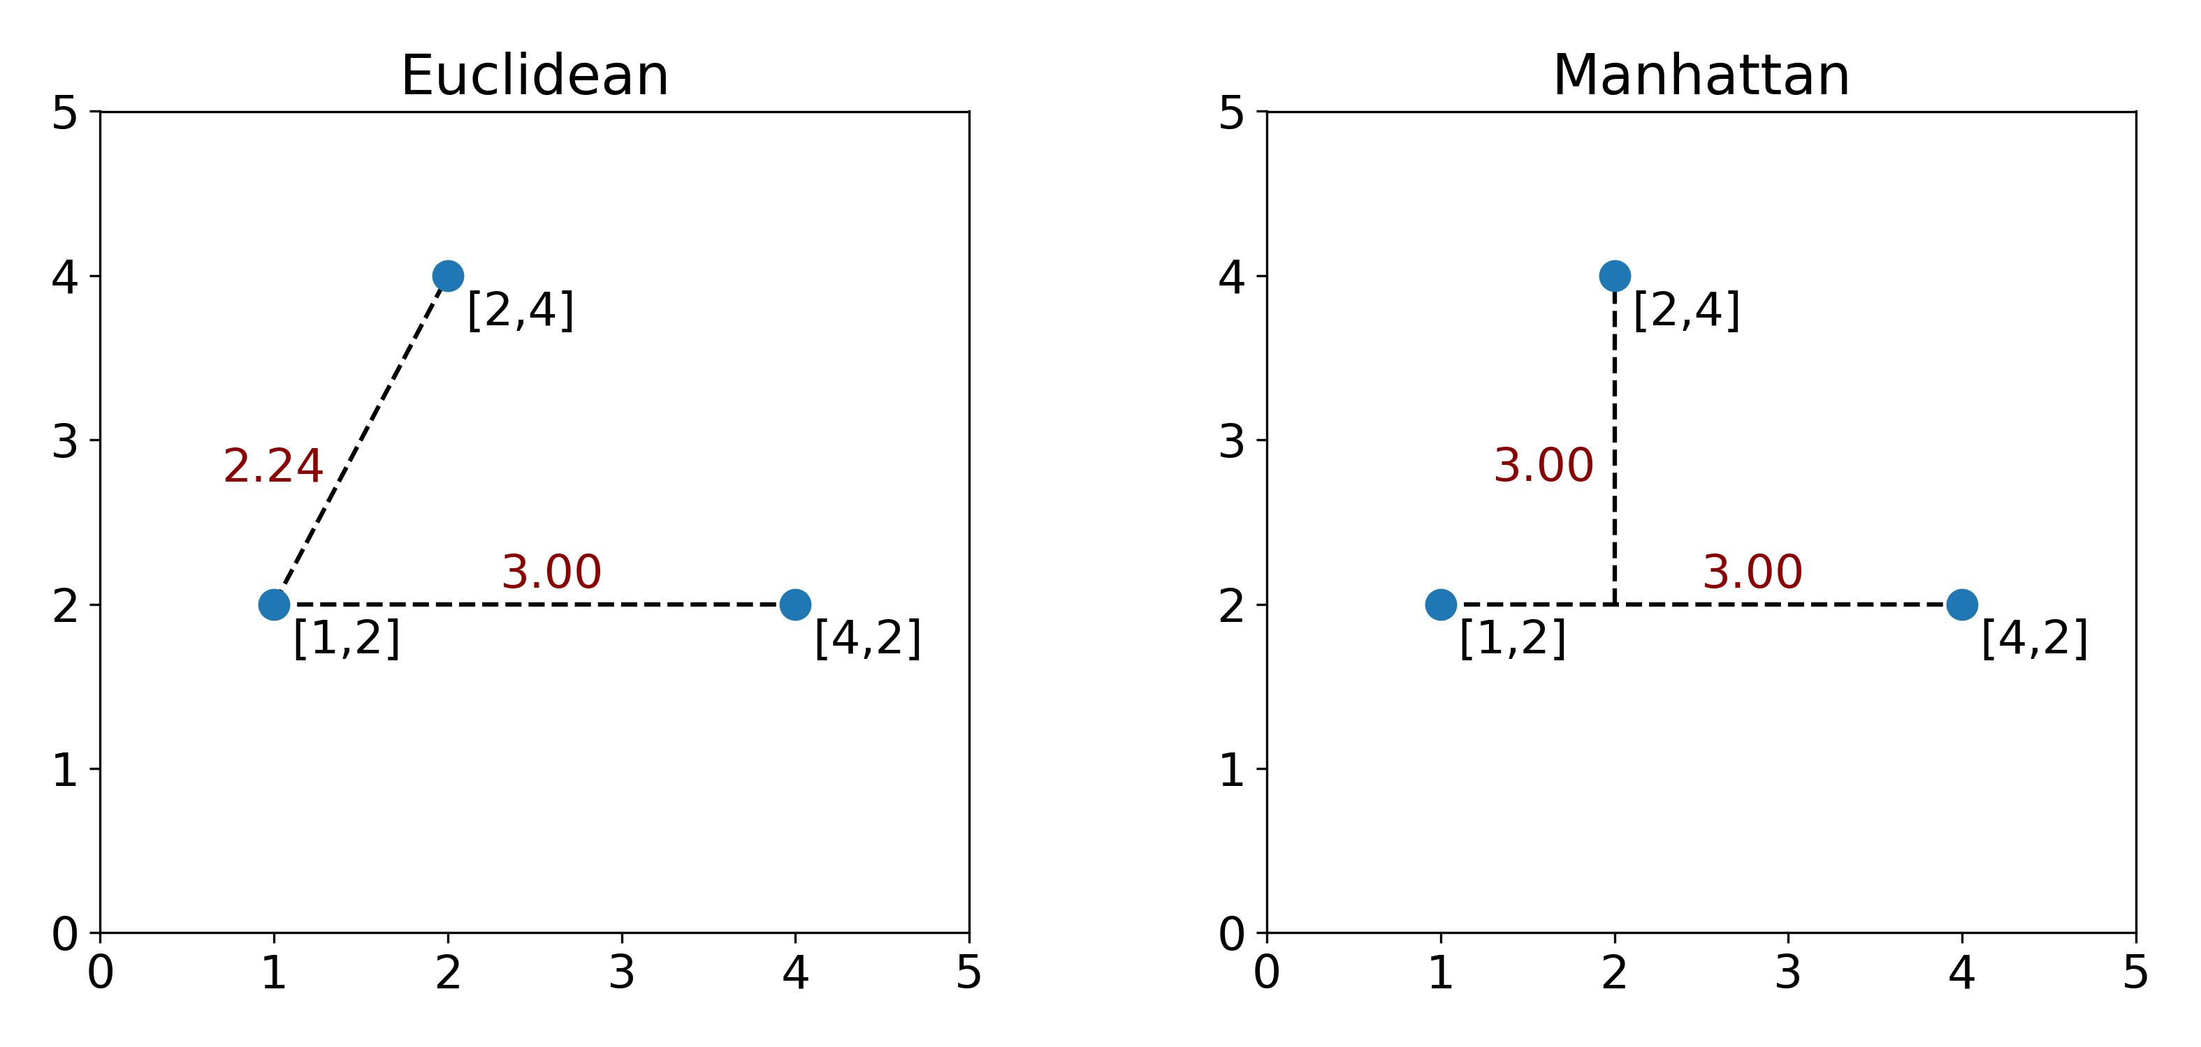

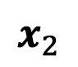


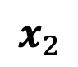
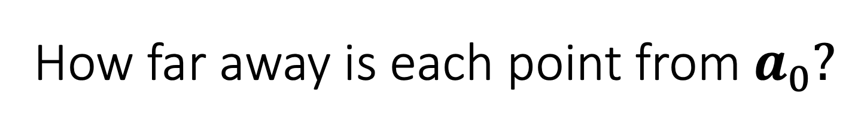
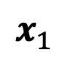
How far away is each point from $a_{0}?$
$$x_{1}$$
$$x_{1}$$
$$x_{2}$$
$$x_{2}$$
$$x_{0}$$
$$x_{0}$$

Slide 13
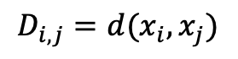
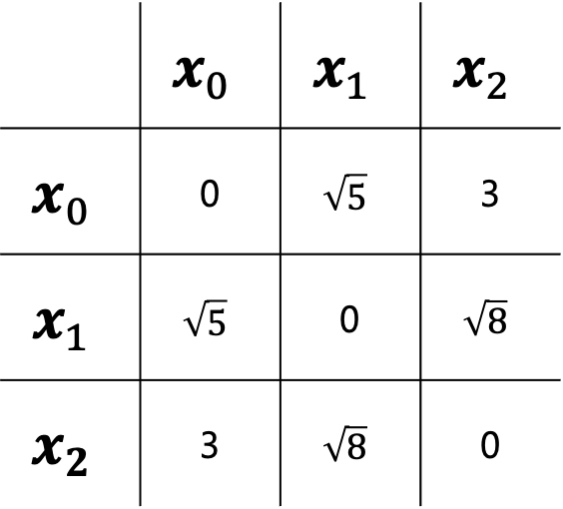



Distance Matrix
 | $$x_{0}$$ | $$x_{1}$$ | $$x_{2}$$
$$x_{0}$$ | 0 | $$\sqrt{5}$$ | 3
$$x_{1}$$ | $$\sqrt{5}$$ | 0 | $$\sqrt{8}$$
$$x_{2}$$ | 3 | $$\sqrt{8}$$ | 0
$$x_{1}$$
D(0,1)
D(1,2)
$$x_{0}$$
$$x_{2}$$
D(0,2)
$$D_{i,j}=d(x_{i},x_{j})$$

Slide 14
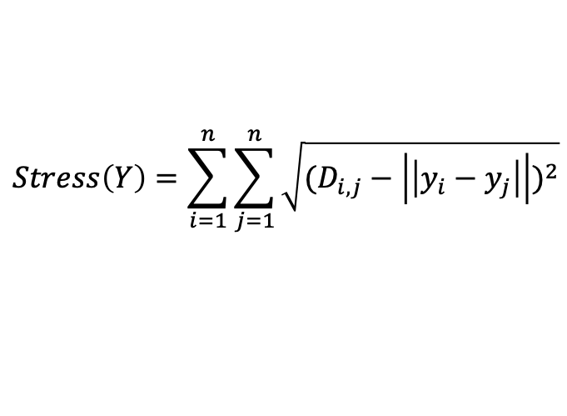

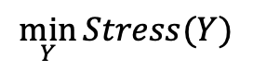
(Metric) Multidimensional Scaling Optimization
$$\min_{Y}{Stress(Y)}$$
$$Stress\left(Y\right)=\sum_{i=1}^{n}{\sum_{j=1}^{n}{\sqrt{{(D_{i,j}−\left|\left|y_{i}−y_{j}\right|\right|)}^{2}}}}$$
Given an $n × n$ distance matrix $D$
Outputs a set of new coordinates for datapoints $Y=\{y_{1},$ $y_{1}$, … $y_{n}$)
Minimizes difference between given distances (from a distance matrix) and Euclidean distances between coordinates
**Generally solved be iterative steepest descent, or a variant called stress majorization

Slide 15
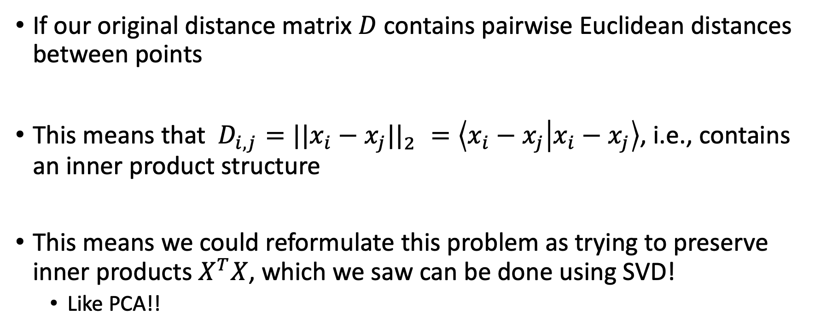

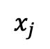
Special case: Classic MDS
If our original distance matrix $D$ contains pairwise Euclidean distances between points
This means that $D_{i,j}={||x_{i}−x_{j}||}_{2}^{}=\left\langle x_{i}−x_{j} | x_{i}−x_{j}\right\rangle$, i.e., contains an inner product structure
This means we could reformulate this problem as trying to preserve inner products $X^{T}X$, which we saw can be done using SVD!
Like PCA!!
$$\overline{x}$$
$$x_{j}$$

Slide 16
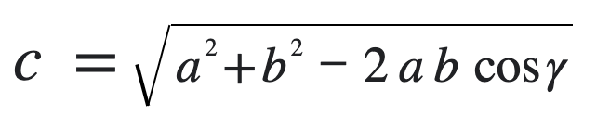
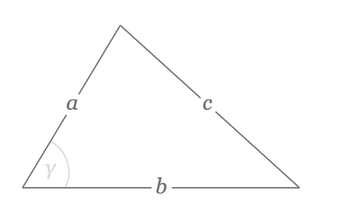
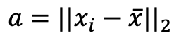
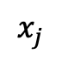


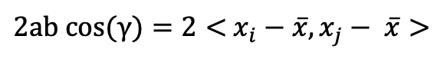

Apply Law of Cosines to D
$$x_{i}$$
$a=||x_{i}−$ $\overline{x}{||}_{2}$
$b=||x_{j}−$ $\overline{x}{||}_{2}$
$$\overline{x}$$
$$x_{j}$$
$2ab cos(γ)=2<$ $x_{i}−$ $\overline{x},x_{j}− \overline{x}>$
$D_{i,j}={||x_{i}− x_{j}{||}_{2}}^{2}={||x_{i}− \overline{x}{||}_{2}}^{2}+{||x_{j}− \overline{x}{||}_{2}}^{2}−$ $2<$ $x_{i}−$ $\overline{x},x_{j}− \overline{x}>$

Slide 17



Reformulate Stress to Strain
$$\min_{Y}{Strain(Y)}$$
$$Strain\left(Y\right)=\sum_{i=1}^{n}{\sum_{j=1}^{n}{\sqrt{\frac{{(B_{i,j}−y_{i}^{T}y_{j}^{})}^{2}}{B_{i,j}^{2}}}}}$$
Here $B_{i,j}=X^{T}X$ —the data Euclidean dot product matrix which can be derived from distance matrix by double centering
$B_{i,j}$=($I_{n}−\frac{1}{n}J_{n})D^{2}$ ($I_{n}−\frac{1}{n}J_{n})$
$I_{n}$ is the identity matrix, $J_{n}$ is a matrix of all 1s in n dimensions

Slide 18


Double Centering
$D_{i,j}^{2}={||x_{i}− x_{j}{||}_{2}}_{2}={||x_{i}− \overline{x}{||}_{2}}^{2}+{||x_{j}− \overline{x}{||}_{\begin{aligned}2 \\ \end{aligned}}}^{2}−$ $2<$ $x_{i}−$ $\overline{x},x_{j}− \overline{x}>$
The last term is the centered data inner product matrix!
We can directly modify $D^{2}$ to get rid of the rest of the terms
Define $B=\frac{1}{n}(I_{n}−J_{n})D^{2}$ $\frac{1}{n}(I_{n}−J_{n})$= $X_{c}^{T}X_{c}$
This operation is called double centering
We can actually ”recover these coordinates” by eigendecomposition
$B=UΛU^{−1}$= $UΛU^{−1}$= $UΛU^{T}$=$U\sqrt{Λ}\sqrt{Λ}$ $U^{T}$➔ $X_{c}^{T}=$ $U\sqrt{Λ}$
$$X_{c}^{T}X_{c}$$

Slide 19

Preserving inner products
Can also solve this using SVD
$B=USV^{T}$
The new coordinates $Y=US$
This gives the EXACT same embedding as PCA
Note*** this will only work when Euclidean distances are chosen

Slide 20

How is this useful?
PCA is a fast way to preserve Euclidean distances
But if we have other distances---like manifold distances---we can derive interesting embeddings that show underlying structure of data

Slide 21


PHATE (MDS on manifold distances)
Shows differentiation structure
Moon et al. Nature Biotechnology 2019

Slide 22
Thought exercise: Other distances?
What are other distances you know?
Are they induced by an inner product?

Slide 23
Thought exercise: Distance preservation?
What are some situations where you might get data as distances
How about data as similarities?

Slide 24
Exercise: MDS
Take 5 US cities, look up distances between them
Create an embedding with cmds, mmds, and nmds
Visualize embeddings
Do they look like map projections?

